Slide 1
Tutorial 9 SSSP, Dijkstra’s, DAGs

Slide 2
Check In
PS7

Slide 3
Quick Recap!
Kahn’s Algorithm

Slide 4
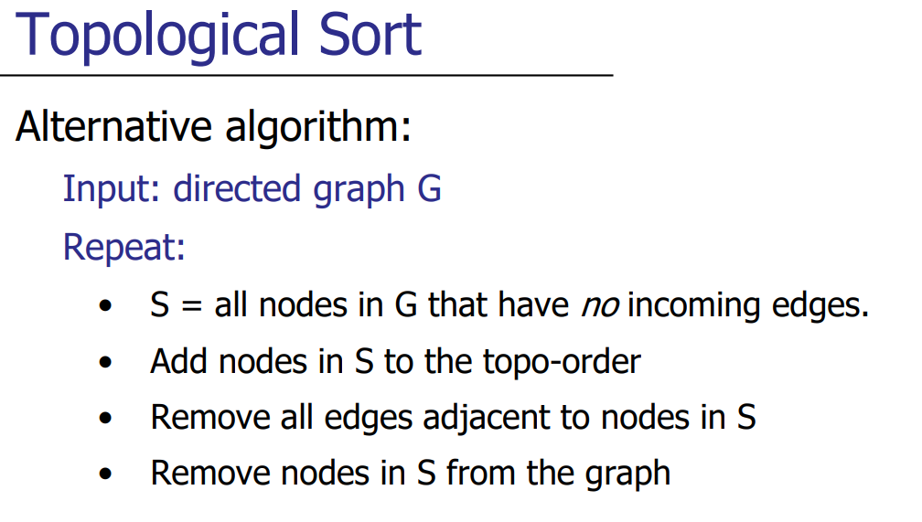
Kahn’s Algorithm

Slide 5
Clean Kitchen
Beat eggs
Mix flour/sugar and eggs
Shop
Turn on oven
Cookies in oven
Measure flour/sugar
Set timer
Take out cookies

Slide 6
Find all nodes with no incoming edges
Beat eggs
Clean Kitchen
Mix flour/sugar and eggs
Shop
Turn on oven
Cookies in oven
Measure flour/sugar
Set timer
Take out cookies

Slide 7
Find all nodes with no incoming edges
Beat eggs
Clean Kitchen
Mix flour/sugar and eggs
Shop
Turn on oven
Cookies in oven
Measure flour/sugar
Set timer
Take out cookies

Slide 8
Add to Topological Order, Remove edges adjacent to nodes
Remove nodes from the graph
Clean Kitchen
Shop
Beat eggs
Turn on oven
Mix flour/sugar and eggs
Cookies in oven
Measure flour/sugar
Set timer
Take out cookies

Slide 9
Find all nodes with no incoming edges
Clean Kitchen
Shop
Beat eggs
Turn on oven
Mix flour/sugar and eggs
Cookies in oven
Measure flour/sugar
Set timer
Take out cookies

Slide 10
Add to Topological Order, Remove edges adjacent to nodes
Remove nodes from the graph
Clean Kitchen
Shop
Turn on oven
Beat eggs
Mix flour/sugar and eggs
Measure flour/sugar
Cookies in oven
Set timer
Take out cookies

Slide 11
Find all nodes with no incoming edges
Clean Kitchen
Shop
Turn on oven
Beat eggs
Mix flour/sugar and eggs
Measure flour/sugar
Cookies in oven
Set timer
Take out cookies

Slide 12
Add to Topological Order, Remove edges adjacent to nodes
Remove nodes from the graph
Clean Kitchen
Shop
Turn on oven
Beat eggs
Measure flour/sugar
Cookies in oven
Mix flour/sugar and eggs
Set timer
Take out cookies

Slide 13
Find all nodes with no incoming edges
Clean Kitchen
Shop
Turn on oven
Beat eggs
Measure flour/sugar
Cookies in oven
Mix flour/sugar and eggs
Set timer
Take out cookies

Slide 14
Find all nodes with no incoming edges
Add to Topological Order, Remove edges adjacent to nodes
Remove nodes from the graph
Shop
Turn on oven
Beat eggs
Measure flour/sugar
Mix flour/sugar and eggs
Clean Kitchen
Set timer
Take out cookies
Cookies in oven

Slide 15
Find all nodes with no incoming edges
Shop
Turn on oven
Beat eggs
Measure flour/sugar
Mix flour/sugar and eggs
Clean Kitchen
Set timer
Take out cookies
Cookies in oven

Slide 16
Add to Topological Order, Remove edges adjacent to nodes
Remove nodes from the graph
Shop
Turn on oven
Beat eggs
Measure flour/sugar
Mix flour/sugar and eggs
Clean Kitchen
Take out cookies
Cookies in oven
Set timer

Slide 17
Find all nodes with no incoming edges
Shop
Turn on oven
Beat eggs
Measure flour/sugar
Mix flour/sugar and eggs
Clean Kitchen
Take out cookies
Cookies in oven
Set timer

Slide 18
Add to Topological Order, Remove edges adjacent to nodes
Remove nodes from the graph
Shop
Turn on oven
Beat eggs
Measure flour/sugar
Mix flour/sugar and eggs
Clean Kitchen
Cookies in oven
Set timer
Take out cookies

Slide 19
Kahn’s Algorithm
What kind of data structure can we use to help us decide which node to remove next?
What would the time complexity be?
To be continued…?

Slide 20
Tutorial Problems
SSSP, Dijkstra, DAGs, oh my!

Slide 21
1a. Mel’s Pizzeria
Welcome to Mel’s Pizzeria! We’re given an undirected graph that represents the locations we have to deliver to, alongside a source node s and destination node t that represents our home. We want to deliver pizzas to places that we pass by on the way to home. But, with every edge e that we take, there’s a probability that we will get a fraction of our pizzas stolen! We want to maximise the amount of pizza we have left.
Design and analyze an algorithm to determine the path from a given start vertex s to a given target vertex t that maximises the fraction of pizza left. We want to run Dijkstra’s, so how do we modify it?

Slide 22
1a. Mel’s Pizzeria
B
0.15
D
0.4
F
0.8
S
0.5
0.9
0.75
0.7
0.1
E
A
0.6
0.9
C
0.85
0.4
T

Slide 23
1a. Mel’s Pizzeria
B
0.15
D
0.4
F
0.8
S
0.5
0.9
0.75
0.7
0.1
E
A
0.6
0.9
C
0.85
0.4
T

Slide 24
1a. Mel’s Pizzeria
D
S
A
C
T
* * * = 0.42525
0.7
0.9
0.9
0.75

Slide 25
1a. Mel’s Pizzeria
D
S
C
A
T
F(pizza left) = 0.7 * 0.9 * 0.9 * 0.75 = 0.42525
We want to maximize F(pizza left), the product of weights from S to T

Slide 26
1a. Mel’s Pizzeria
We want to maximise F(pizza left), the product of weights from S to T
Modify the relax step:
- Convert the addition to a multiplication
- Relax if the result is greater, instead of smaller
Additional Consideration:
- Modify the initial estimates to 0, rather than inf (except source node s which has fraction 1 = full pizza)

Slide 27
1b. Mel’s Pizzeria
Are there any other ways of finding the optimal path without modifying the relax function?

Slide 28
1b. Mel’s Pizzeria
We want to maximise F(pizza left), the product of weights from S to T
Without modifying the relax function:
We want to add edge weights, and find a minimum
How do we convert a multiplication into an addition?
Log!
Given weights u, v:
log(uv) = log(u) + log(v)
We also have to negate the logarithms! Minimising the sum of -log(e) is equivalent to maximising sum of log(e) and hence maximising the product of the edges

Slide 29
2. Running Trails
I want to go for a run. I want to go for a long run, starting from my home and ending at my home. And I want the first part of the run to be only uphill, and the second part of the run to be only downhill. I have a trail map of the nearby national park, where each location is represented as a node and each trail segment as an edge. For each node, I have the elevation (value shown in the node). Find me the longest possible run that goes first uphill and then downhill, with only one change of direction.

Slide 30
2. Running Trails
I want to go for a run. I want to go for a long run, starting from my home and ending at my home. And I want the first part of the run to be only uphill, and the second part of the run to be only downhill. I have a trail map of the nearby national park, where each location is represented as a node and each trail segment as an edge. For each node, I have the elevation (value shown in the node). Find me the longest possible run that goes first uphill and then downhill, with only one change of direction.

Slide 31
2. Running Trails
Three key insights:
1. Each edge represents two traversals between the endpoints u and v: one uphill, and one downhill
2. There can be no uphill/downhill cycles
3. If we find the longest path uphill from home to a node u, we have also found the longest path downhill from the node u to home

Slide 32

2. Running Trails
2
1
3
3
2
4
1
6
5
2
1
3
6
1
7

Slide 33
Convert to a DAG – each edge points uphill (resp. downhill)
2
1
3
3
2
4
1
6
5
2
1
3
6
1
7

Slide 34
Find longest path from home to any other node (resp. any node to home)
2
1
3
3
2
4
1
6
5
2
1
3
6
1
7

Slide 35
Mirror the path back home (resp. to the node)
1
4
3
3
3
2
5
1
7
1
4
3
3

Slide 36
2*. Running Trails EX
First, what if we don’t necessarily end at home? Suppose we want to end at some other node.
That’s a bit too easy. Let’s modify the problem with three extensions.
2
1
3
Second, let’s also start at a different node.
3
2
4
1
6
5
2
Finally, let’s allow for multiple changes in direction.
1
3
6
1
7

Slide 37
2*. Running Trails EX
The key idea of converting to a DAG remains the same.
However, we cannot simply mirror the longest route, since our start and destination are different.
2
1
3
3
2
4
1
6
5
2
1
3
6
1
7

Slide 38
Generate two DAGs – one uphill, one downhill
2
1
3
3
2
4
1
6
5
2
1
3
6
1
7
2
1
3
3
2
4
1
6
5
2
1
6
3
1
7

Slide 39
Connect all nodes with their counterparts, with weight 0
2
1
3
3
2
4
1
6
5
2
1
3
6
1
7
2
1
3
3
2
4
1
6
5
2
1
6
3
1
7

Slide 40
We start on the uphill DAG, and end on the downhill DAG
2
1
3
3
2
4
1
6
5
2
1
3
6
1
7
2
1
3
3
2
4
1
6
5
2
1
6
3
1
7

Slide 41
Return the longest path
2
1
3
3
2
4
1
6
5
2
1
3
6
1
7
2
1
3
3
2
4
1
6
5
2
1
6
3
1
7

Slide 42
For more changes in direction, add more ‘layers’
2
1
3
3
2
4
1
6
5
2
1
3
6
1
7
2
1
3
3
2
4
1
6
5
2
1
6
3
1
7

Slide 43
3a. Bad Dijkstra
Give an example of a graph where Dijkstra’s Algorithm returns the wrong answer.

Slide 44
3a. Bad Dijkstra
Graph with negative weights
A
A
A
A
2
1
2
1
2
1
2
1
B
-2
C
B
-2
C
B
-2
C
B
-2
C
A
0
A
0
A
0
A
0
B
∞
B
2
B
2
B
2
C
∞
C
1
C
1
C
1
A’s distance correct
C’s distance correct
B’s distance correct
C is assumed correct, and not changed

Slide 45
3b. Bad Dijkstra
Give an example of a graph where Dijkstra’s Algorithm returns the correct answer but is a poor choice.

Slide 46
3b. Bad Dijkstra
Evaluate SSSP options and choose wisely!
Examples:
Trees
BFS/DFS: O(V + E)
Dijkstra’s: O(E log V)
DAGs
Topological Sort + Relaxing Edges in Order: O(V + E)
Dijkstra’s: O(E log V)

Slide 47
4a. A Random Problem With a Dude Called Dan
Dan is on his way home from work. The city he lives in is made up of N locations, labelled from 0 to (N − 1). His workplace is at location 0 and his home is at location (N −1). These locations are connected by M directed roads, each with an associated (nonnegative) cost. To go through a road, Dan will need to pay the cost associated with that road.
For reasons unknown, he wants to flaunt his wealth by going through a really expensive road. However, he still needs to be able to make it back home with the money he has. Given that Dan can afford to spend up to D dollars on transportation, help him find the cost of the most expensive road that he can afford to go through on his journey back home.

Slide 48
4a. A Random Problem … Dan
7
5
1
2
2
4
6
5
7
2
10
1
3
5
3
1
2
0

Slide 49
4a. A Random Problem … Dan
7
5
1
2
2
4
6
5
7
2
10
1
3
5
3
1
2
0

Slide 50
Method 1
How do we know if an edge between two nodes (u, v) can lie on a valid path?
D >= Σ
Shortest path from 0 to u
weight(u, v)
Shortest path from v to N - 1

Slide 51
Dijkstra on original and transposed graphs
Shortest path from 0 to u
Shortest path from v to N - 1
7
4
0
7
2
8
4
3
12
6
2
5
1
4
2
6
1
3
3
1
2
5
1
8
3
3
12
5
0
0
4
0

Slide 52
Method 1
D >= Σ
Shortest path from 0 to u
weight(u, v)
Shortest path from v to N - 1
After preprocessing: Calculate in O(1) time!
Then simply return the maximum weight that satisfies the above
Overall runtime:
O(M log N + M) = O(M log N)

Slide 53

Method 2
Restatement of the question:
What is the greatest value k, for which a path (a) goes through an edge of (at least) weight k and (b) does not have total weight exceeding D?
Define $P_{K}$ to be the above property, and the desired value $K_{max}$.
Key insight:
$P_{k}$ is True for all $K≤K_{max}$.
Hence, we can find $K_{max}$ through binary search!
Search space: the set of all edge weights.

Slide 54

Method 2
Given a K, how do we test if $P_{k}$ holds?
Suppose K = 5.
7
7
5
1
2
5
1
2
2
4
6
2
4
6
5
7
2
10
5
7
2
10
1
3
5
1
3
5
3
1
2
3
1
2
0
0

Slide 55
Method 2
Given a K, how do we test if $P_{k}$ holds?
7
7
5
1
2
5
1
2
2
4
6
2
4
6
5
7
2
10
5
7
2
10
1
3
5
1
3
5
3
1
2
3
1
2
0
0

Slide 56
Method 2
Given a K, how do we test if $P_{k}$ holds?
Consider all edges with weight >= K
7
7
5
1
2
5
1
2
2
4
6
2
4
6
5
7
2
10
5
7
2
10
1
3
5
1
3
5
3
1
2
3
1
2
0
0

Slide 57
Method 2
Given a K, how do we test if $P_{k}$ holds?
Connect them to the duplicate graph: (u, v) becomes (u, v’)
7
7
5
1
2
5
1
2
2
4
6
2
4
6
5
10
7
7
2
5
2
10
1
3
5
1
3
5
3
1
2
3
1
2
0
0

Slide 58
Method 2
Given a K, how do we test if $P_{k}$ holds?
Perform SSSP
7
7
5
1
2
5
1
2
2
4
6
2
4
6
5
10
7
7
2
5
2
10
1
3
5
1
3
5
3
1
2
3
1
2
0
0

Slide 59
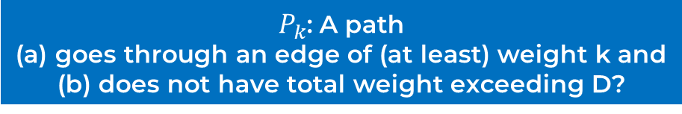
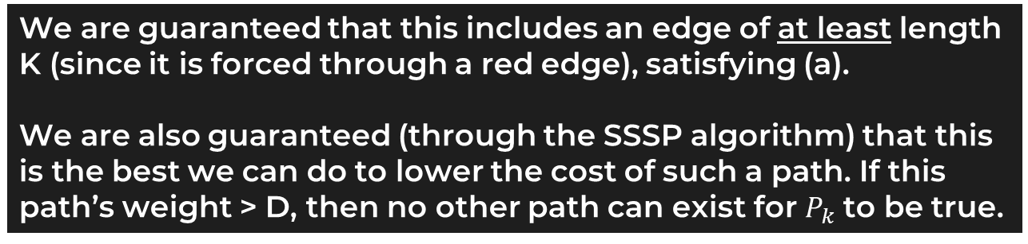
Method 2
Given a K, how do we test if $P_{k}$ holds?
$P_{k}$: A path (a) goes through an edge of (at least) weight k and (b) does not have total weight exceeding D?
Perform SSSP
We are guaranteed that this includes an edge of at least length K (since it is forced through a red edge), satisfying (a).
We are also guaranteed (through the SSSP algorithm) that this is the best we can do to lower the cost of such a path. If this path’s weight > D, then no other path can exist for $P_{k}$ to be true.

Slide 60
Method 2
Runtime Analysis
Perform SSSP on duplicated graphs: 2x vertices and edges
= O(2M log 2N)
= O(M log N)
Binary search through M edges: O(log M)
Total Runtime: $O\left(M\log{N}\log{M}\right)=O\left(M{\left(\log{N}\right)}^{2}\right)$

Slide 61
4b. Dan 2 electric boogaloo
This time, however, instead of maximizing the cost of the most expensive road in his journey, he wants to maximize the cost of the second most expensive road in his journey.

Slide 62
4b. Dan the Salaryman
Method 1:
Doesn’t work!
Method 2:
Can be adapted
How?
Instead of forcing through 1 red edge, force through 2!

Slide 63
Instead of forcing through 1 red edge, force through 2!
3
3
3
8
6
8
6
8
6
1
2
2
1
2
2
1
2
2
1
5
1
5
1
5
0
0
0

Slide 64
Instead of forcing through 1 red edge, force through 2!
3
3
3
8
6
8
6
8
6
1
2
2
1
2
2
1
2
2
1
5
1
5
1
5
0
0
0

Slide 65
Instead of forcing through 1 red edge, force through 2!
Suppose K = 5.
3
3
3
8
6
8
6
8
6
1
2
2
1
2
2
1
2
2
1
5
1
5
1
5
0
0
0

Slide 66
Instead of forcing through 1 red edge, force through 2!
Perform SSSP.
3
3
3
8
6
8
6
8
6
1
2
2
1
2
2
1
2
2
1
5
1
5
1
5
0
0
0

Slide 67
Instead of forcing through 1 red edge, force through 2!
3
3
3
8
6
8
6
8
6
1
2
2
1
2
2
1
2
2
1
5
1
5
1
5
0
0
0

Slide 68
4b. Dan the Everyman
Reasoning for correctness is essentially the same as 4a. SSSP guarantees the shortest path, so we only need to verify one path per K, and the red edges ensure that a weight of K is attained.
Runtime Analysis
SSSP over an additional duplicate: O(3M log 3N) = O(M log N)
Binary searching: O(log M)
Total Runtime: $O\left(M\log{N}\log{M}\right)=O\left(M{\left(\log{N}\right)}^{2}\right)$
Same as the previous part!

Slide 69
3. Longest Path
Given a DAG, compute the longest possible path that you can take.

Slide 70
3. Longest Path
Given a DAG, compute the longest possible path that you can take.
3a) For a node u, let N(u) be the set of nodes that node u has edges to (i.e set of neighbours) How do we find the longest path in the graph that starts at node u? Write this as a recurrence. In particular, lp(u) should be written in terms of lp(v) for all v in N(u).

Slide 71
3. Longest Path
Given a DAG, compute the longest possible path that you can take.
3a) For a node u, let N(u) be the set of nodes that node u has edges to (i.e set of neighbours) How do we find the longest path in the graph that starts at node u? Write this as a recurrence. In particular, lp(u) should be written in terms of lp(v) for all v in N(u).
Solution: lp(u) = max(lp(v)) for all v in u + 1 (edge from u to v)

Slide 72
3. Longest Path
Given a DAG, compute the longest possible path that you can take.
3b) For a given node u, how long does it take to compute lp(u)?

Slide 73

3. Longest Path
Given a DAG, compute the longest possible path that you can take.
3b) For a given node u, how long does it take to compute lp(u)?
Solution: Starting at node u, we need to recursively compute lp(v) for all neighbours v of u
After we do so, as a post-traversal operation, take the maximum of computed values and add 1 to it = post-order DFS!
Runtime: $O\left(V+E\right)$

Slide 74
3. Longest Path
Given a DAG, compute the longest possible path that you can take.
3c) How can we compute the longest path in the graph (i.e across all the nodes in the graph, find max lp(u)) in O(V + E) time?

Slide 75
3. Longest Path
Given a DAG, compute the longest possible path that you can take.
3c) How can we compute the longest path in the graph (i.e across all the nodes in the graph, find max lp(u)) in O(V + E) time?
Solution: Toposort the graph, and compute lp(u) in reverse toposort order. For a given node u, after we compute lp(u), store it in a hash table so that we can retrieve the value later = memoisation!
This way, given a node u, when trying to calculate the maximum lp(v) of all its neighbours, the value can be easily retrieved (O(1)) and the runtime is just O(|N(u)|) = O(outdeg(u)) time

Slide 76
See you next week?

